Slide 1
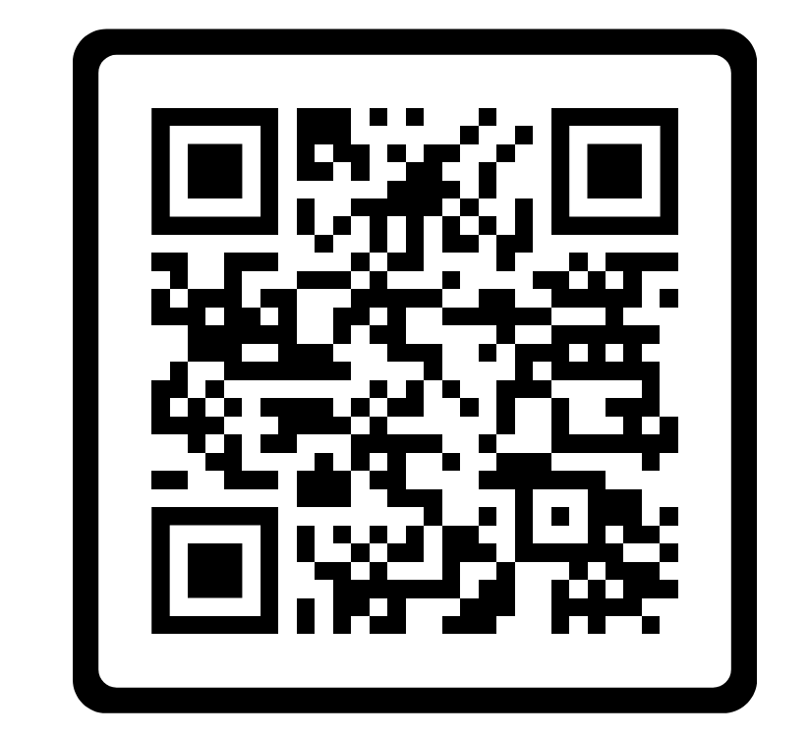




Predicting open source contributor turnover from value-related discussions: An analysis of GitHub issues
Full paper:
jackjamieson.net/icse2024/
jack@jackjamieson.net
Jack Jamieson NTT Kyoto, Japan | Naomi Yamashita NTT Kyoto, Japan | Eureka Foong Tokyo College, University of Tokyo, Japan

Slide 2
Values and software engineering
Values: “Guiding principles of what people consider important in life” (Cheng & Fleischmann, 2010)
Positive social impact
Effect on software contributors’ motivation
Build software that
Supports “positive” values
Avoids “value violations”
Values can attract likeminded contributors
Value-related conflict can increase turnover
Notes:
I'm going to be talking about values in software engineering.
When I mean by values is [read definition]
e.g., privacy, security freedom, justice, compassion
For good reason, there are increasing calls to better incorporate values into software engineering processes like requirements engineering or developer discussions. These are mostly aimed at building software that has a positive effect on society.
Support “positive”. Avoid “value violations”. (Obie)
Another important consideration is how engaging with values can affect the motivation of contributors to software projects.
People may be motivated to contribute to projects that match their values
Value-related discussions can often result in conflict. Since values are deeply held beliefs, this can be heated. Past research suggests this can lead to contributors leaving projects.

Slide 3
Effect on software contributors’ motivation
In sum, engaging with values during software development seems to affect contributor turnover
Values can attract likeminded contributors
Value-related conflict can increase turnover
Limitation: Prior research is based on surveys and interviews
Recruitment bias
Self-report bias (words != actions)
Difficult to quantify potential relationships between values and turnover.
Notes:
Prior work has found that engaging with values during development can affect turnover.
[Go through the points on the slide]
This means it is difficult to quantify potential relationships between values and turnover, even though prior research tells us these relationships are important.
That sets up the motivation for this project. We measure actual behavior using logs from open source software projects, and we ask [NEXT SLIDE]

Slide 4
To what extent do changes in the percentage of discussions that are related to values predict significant changes in contributor turnover?
Notes:
delete github?

Slide 5
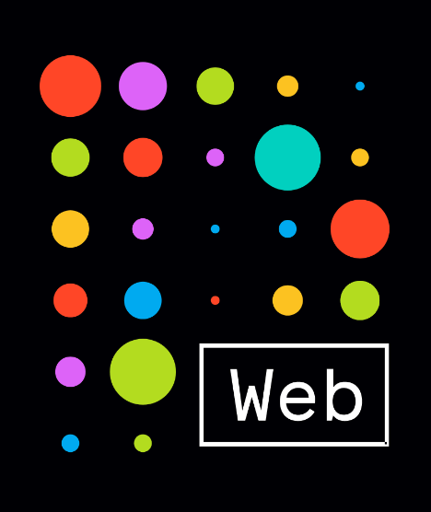
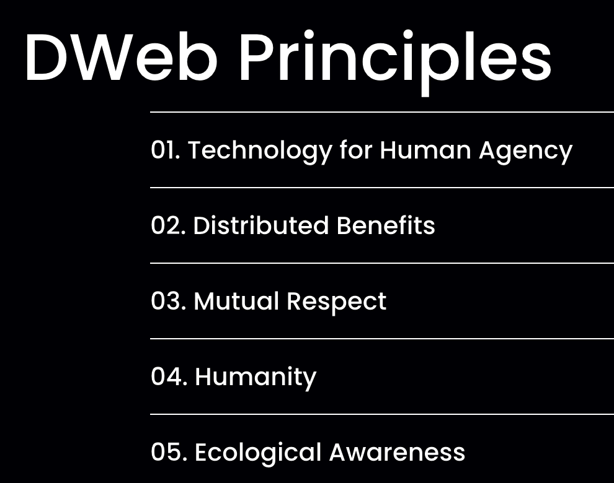
Research site: DWeb projects on GitHub
https://getdweb.net
Community of companies, teams, and individuals building Decentralized Web infrastructures.
Key benefits for this study:
Shared commitments to values, articulated in the “Dweb Principles”
Most projects are open-source and on GitHub.
Notes:
We focus on a specific community called DWeb.

Slide 6
Research model
Collect data (GitHub API)
52 projects
~780,000 issue comments
~780,000 commits
2016 – 2022
Incoming turnover:
% of contributors who made their first contribution each month
Quantify turnover rates (per project per month)
Outgoing turnover:
% of contributors who made their final contribution each month
Define dictionary of keywords representing core DWeb values:
Respectfulness
Broadmindedness
Freedom
Equity and Equality
Social Power
Protecting the Environment
Detect value-related discussions using keyword-matching
Quantify % of discussions each month related to each value

Slide 7
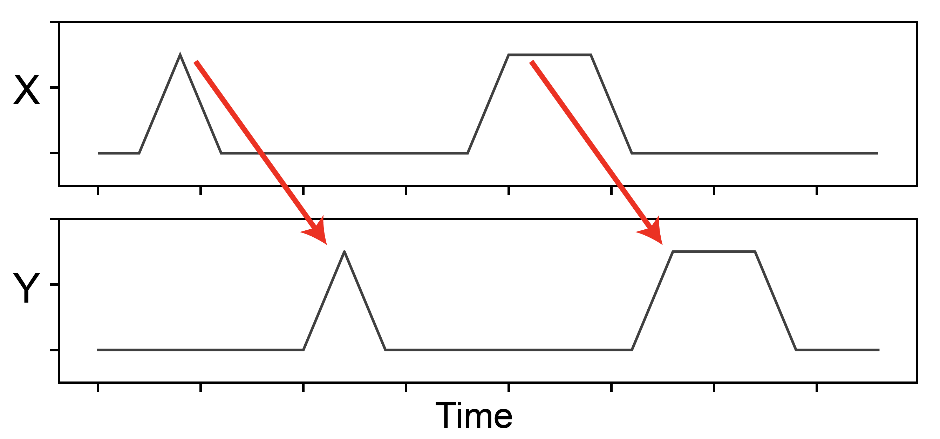
Compare two timelines (by project, by month):
X: Percentage of discussions related to {value}
Y: Turnover rates (incoming, outgoing)
Granger causality analysis: Does an increase in X predict a change in Y?
Illustration of perfect Granger Causality:
Impulse Response Function
← One month later
Notes:
This analysis gives us two sets of timelines. [Read X, Y]

Slide 8
Highlighted findings

Slide 9
“Respectfulness”
Top terms: code of conduct; polite; rude
64% discussion-focused
Generally, complaints about others’ behaviour:
”failure to respond here, while continuing to post in other groups, is rude” “This is the second time you opened a new issue specifically to circumvent a prior issue’s closure. Continuing to do so is in violation of the code of conduct.”
Notes:
64%

Slide 10
After an increase in“respectfulness” discussions…
→ More people quit
→ Fewer people join
Notes:
These charts show that, if the percentage of ”respectfulness” discussions increases by one standard deviation one month, then the outgoing turnover rates will also increase

Slide 11
“Freedom” issues
Top terms: freedom; user choice; sovereign
100% Product-focused
About the role of “freedom” in the software
“[This feature allows] the developer to have more freedom to structure the implementation of the user module instance.”
“[Opposing] Social power” issues
Top terms: central authority; gatekeeper; monopoly
~99% Product-focused
About opposing concentrations of “social power” in the software
“what DIDs do is allow one to find cryptographic material proven to be associated with a given identifier, without a central authority involved.”
Notes:
This was very

Slide 12
“Freedom” and “social power”
Notes:
An increase in freedom discussions resulted in fewer people leaving, among these relatively short term contributors.
An increase in social power discussions resulted in fewer people leaving across both short term medium term contributors.

Slide 13
Summary of findings
“Respectfulness” discussions
(Generally) interpersonal conflict about disrespectful collaborator behaviour. Predicts... more people leaving and fewer people joining.
“Freedom” and “Social power” discussions
(Generally) about designing the software to reflect shared values.
Predicts... fewer people leaving.

Slide 14
Implications
Open source project dashboards could monitor value-related discussions. e.g., CHAOSS [1], Climate Coach [2]
Monitoring conflicts about values could help gauge project health
(especially “respectfulness”)
[1] Sean P. Goggins, Matt Germonprez, and Kevin Lumbard. 2021. Making Open Source Project Health Transparent. Computer 54, 8 (2021), 104–111.
[2] Huilian Sophie Qiu et al. 2023. Climate Coach: A Dashboard for Open-Source Maintainers to Overview Community Dynamics. CHI ’23
Notes:
If these types of conflicts occur, maintainers may want to pay attention so they can resolve them.
Predicting (and preventing) turnover may be important during project growth stages
CHAOSS - Community Health Analytics in Open Source Software.

Slide 15
Implications
Freedom and social power:
Discussions that integrate widely-agreed-upon values with technical work may motivate sustained contributions.
Maintainers and managers may increase motivation by highlighting relationships between shared values and technical decisions.

Slide 16
Implications
Toxicity detection is very difficult in software engineering contexts, especially for subtle toxicity.
”Respectfulness” discussions identified non-verbal and subtly toxic behavior that would be missed by most NLP approaches.
Identifying reactions (e.g., accusations of disrespectfulness) may improve detection of subtle toxicity.
Notes:
”Respectfulness” discussions identified subtly toxic behavior that would be missed by most NLP approaches.
Including “disrespecful” behavior that

Slide 17
Thank you!
Full paper:
jackjamieson.net/icse2024/
jack@jackjamieson.net
Jack Jamieson NTT Kyoto, Japan | Naomi Yamashita NTT Kyoto, Japan | Eureka Foong Tokyo College, University of Tokyo, Japan
Notes:
There’s more in the full paper, so please take a look. Most of all, thanks for listening and I’m happy to answer any questions.

Slide 18
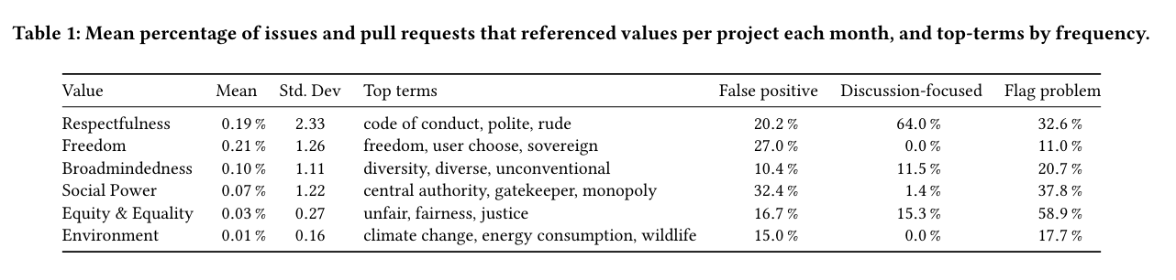

Slide 19
Discussion – What do we mean by “predicts”?
Disrespectful behavior
Discussions about "respectfulness"
Increase in project turnover
Q: Do discussions about respectfulness cause turnover?
Notes:
If this were the case, then project moderators would be able to reduce turnover by deleting discussions about respectfulness.

Slide 20
Discussion – What do we mean by “predicts”?
Disrespectful behavior
Discussions about "respectfulness"
Increase in project turnover
Q: Do discussions about respectfulness cause turnover?

